Slide 1
Breast cancer recognition with deep learning
Applied Deep Learning Course Project
Taj Eli Mitchell

Slide 2
Executive Summary

Slide 3
Executive Summary
Inspired by the 2017 paper “Detecting Cancer Metastases on Gigapixel Pathology Images, ” this presentation will discuss the challenge of breast cancer detection and the results of two neural network models that have been trained on biopsy images from the CAMELYON16 dataset.
The two models that will be discussed have been trained on roughly 14 images, at level 3 and 2 resolutions, respectively.
The goal of this project was to produce at least one working model, capable of assisting physicians in detecting tumor cells by generating a heatmap over a biopsy sample. The output heatmap can then assist pathologist by serving as a second opinion.
The models generated during this project managed to achieve varying results:
Predictions made by the level 3 model, managed to achieve as much as 88% and as low as 50% accuracy (f1 metric) on images reserved for testing
Predictions made by the level 2 model, managed to achieve as much as 94% and as low as 36% accuracy (f1 metric) on images reserved for testing
Despite these results, both models succeeded in identifying all of the cancer tissue contained in the biopsy samples. Accuracy diminished due to each model predicting false positive regions.
The conclusive analysis of this project demonstrates the success of both models as well as several simple changes that can improve accuracy, namely; additional training, additional RAM and GPU capacity, and model ensembles

Slide 4
Project Motivation

Slide 5
Breast Cancer and Deep Learning
Each year, within the United States, roughly 70,000 breast cancer patients are misdiagnosed due to the challenge pathologist face when manually evaluating breast tissue biopsies.
In response to this issue, research institutions throughout the world have begun identifying the capacity for artificial intelligence to assists doctors in detecting tumor cells during the review of biological tissues.
Motivated by the success “Deep Learning” techniques (branch within the broader spectrum of AI) have achieved in image recognition/ classification challenges, researchers at Google, Verily Life Sciences, and Mountain View published a joint paper in 2017 discussing their success in designing a Deep Learning model for detecting tumor cells, which achieved 92.4% accuracy
This success has gone on to serve as a benchmark and reference for students, researchers, and corporations interested in the potential solutions that can be implemented using Deep Learning

Slide 6
Deep Learning Models

Slide 7
Model Selection
Prior to delving into each model’s results, it is important to discuss several key implementation choices that are prevalent in both models:
Input layers leverage InceptionV3 architecture, initially trained on ImageNet images
A single GlobalAverage Pooling, Dense ReLu, and Sigmoid layer were implemented as the output layers
Adam optimizer was used for both models due to superior results in training versus SGD
Models were trained for 40 epochs of batch size 192
The first 20 epochs focus only on training the output layer (InceptionV3 layers are frozen)
Last 20 epochs allow for both the dense and inception layers to adjust

Slide 8
Evaluation Metrics
In addition to model selection, several key metrics were chosen to evaluate performance, particularly since the traditional accuracy measure simply assess (correct predictions)/(total predictions). For this project, accuracy isn’t a suitable metric since the amount of cancer images is significantly smaller than noncancer images, allowing the model to report 90% accuracy without learning to recognize tumor images.
Recall (recall_m): (Correctly predicted cancer images)/ Total Cancer Images in the dataset
Precision (precission_m): (Correctly predicted cancer images)/ (Total Images predicted as cancer)
F1 Score (f1_m): Harmonic mean between Recall and Precision. Higher % reflects both high recall and high precision. Low % reflects either one or both metrics scoring significantly low.
The advantage of using the aforementioned metrics to evaluate accuracy is that they solve the primary issue regarding class imbalance. In addition, each metric encapsulates the performance of the model with respect to identifying cancer regions, which is the primary objective of the model.

Slide 9
Deep Learning Models
Model I
Level 3 Resolution

Slide 10
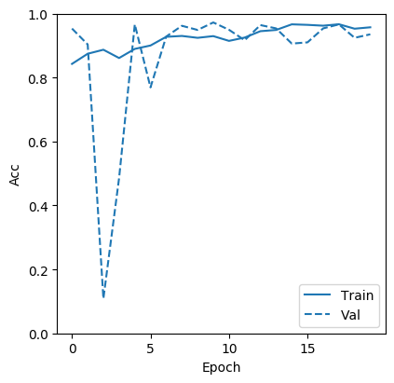
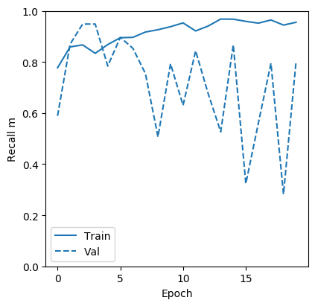
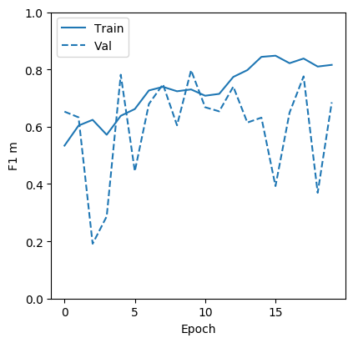
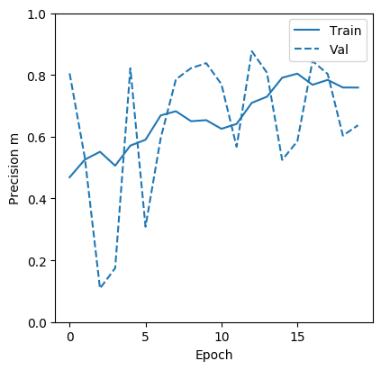
Model 1 Training Results
Note: Model 1 was trained on 7,327 images of size 299 x 299, comprised of tissue from 18 distinct biopsy images (1,832 validation images). The above training images reflect the 20 epochs during which both the Inception and Dense layers trained.

Slide 11
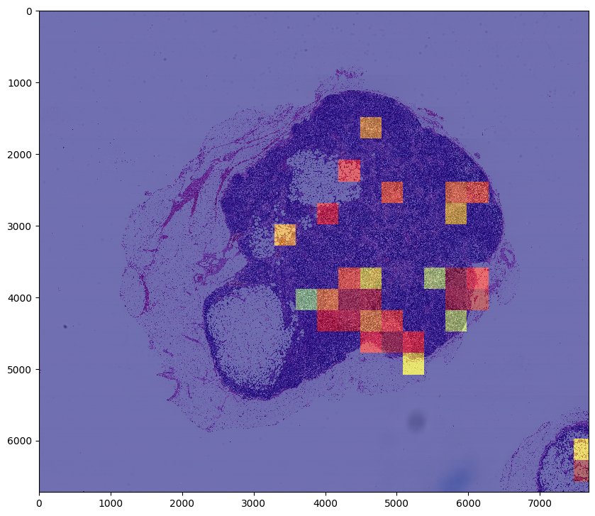
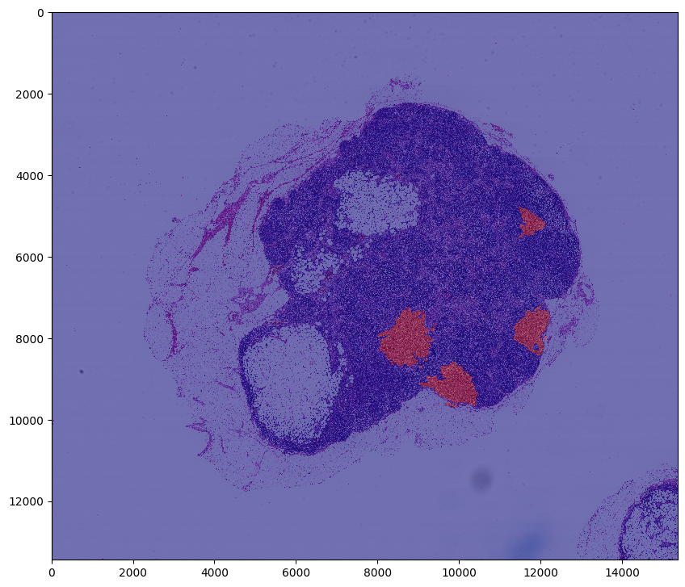
Model 1 Prediction A
Model 1 Prediction – Image 091
Ground Truth – Image 091
f1: 0.7719245675915414
recall: 0.8148145130316619
precision: 0.7333330888889704

Slide 12
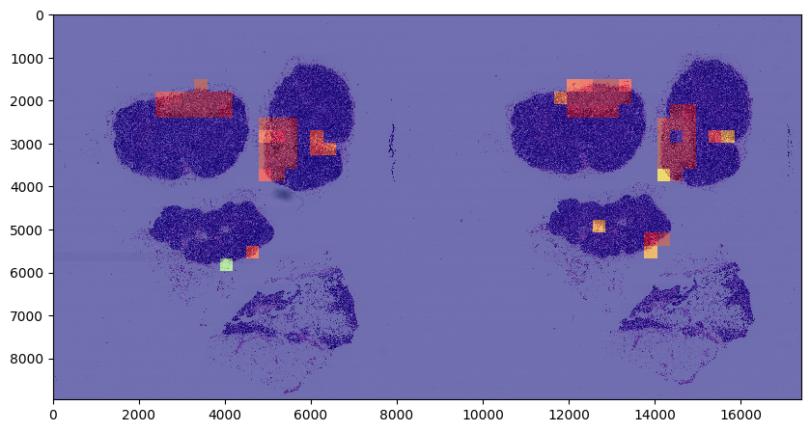
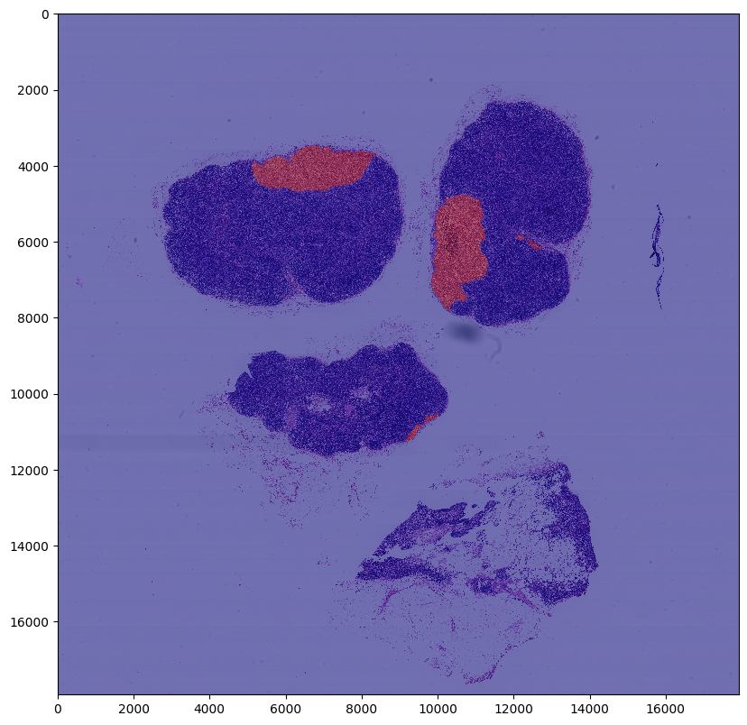
Model 1 Prediction B
Model 1 Prediction – Image 101
Ground Truth – Image 101
f1: 0.8799949262501424
recall: 0.8048779506246402
precision: 0.9705880925605745

Slide 13
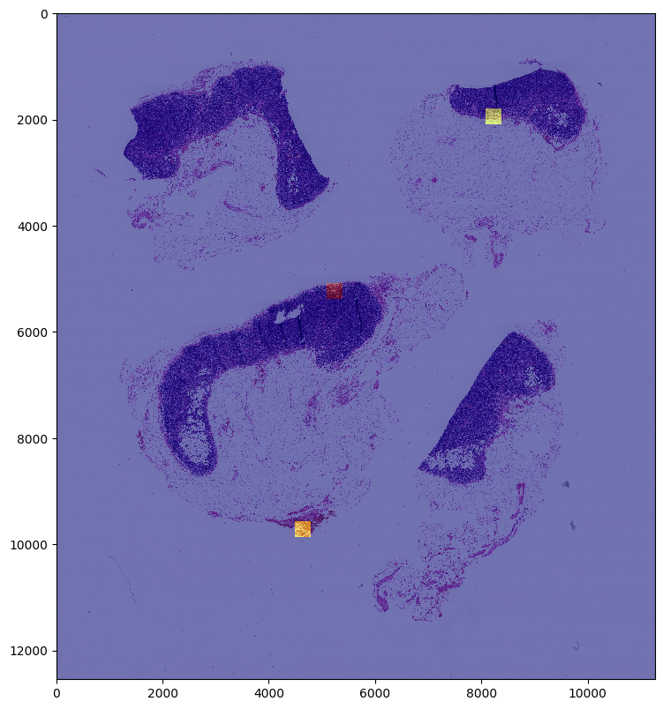
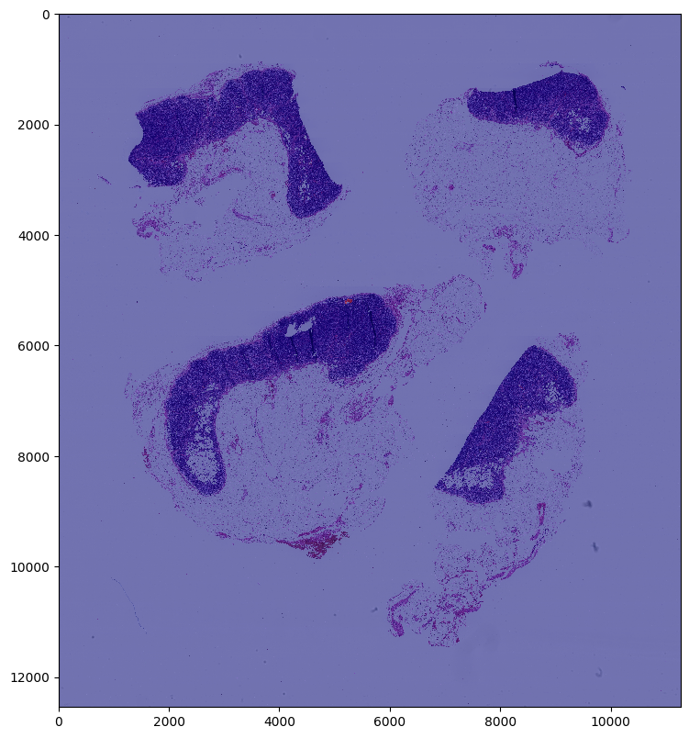
Model 1 Prediction C
Model 1 Prediction – Image 081
Ground Truth – Image 081
f1: 0.4999937500281251
recall: 0.9999900000999989
precision: 0.3333322222259259

Slide 14
Deep Learning Models
Model II
Level 2 Resolution

Slide 15
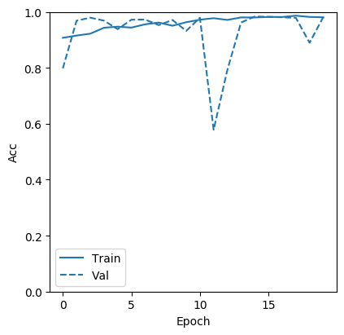
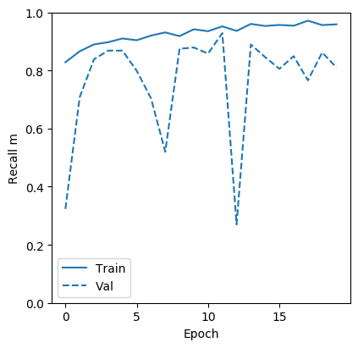
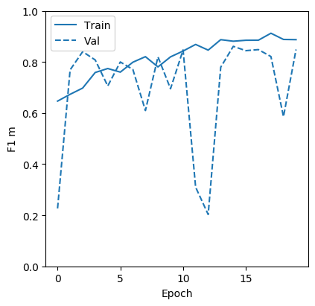
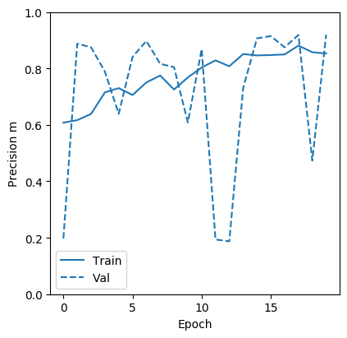
Model 2 Training Results
Note: Model 2 was trained on 24,299 images of size 299 x 299, comprised of tissue from 18 distinct biopsy images (6,075 validation images). The above training images reflect the 20 epochs during which both the Inception and Dense layers trained.

Slide 16
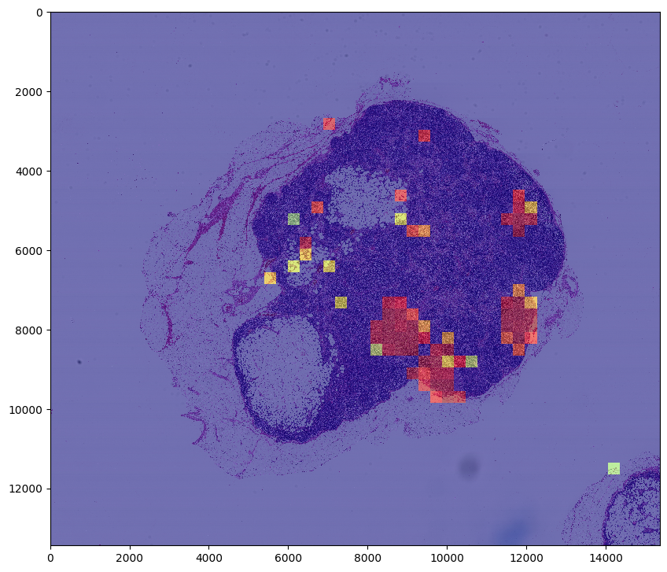
Model 2 Prediction A
Model 2 Prediction – Image 091
Ground Truth – Image 091
f1: 0.7499948968311738
recall: 0.7605632731601023 precision: 0.7397259260649416

Slide 17
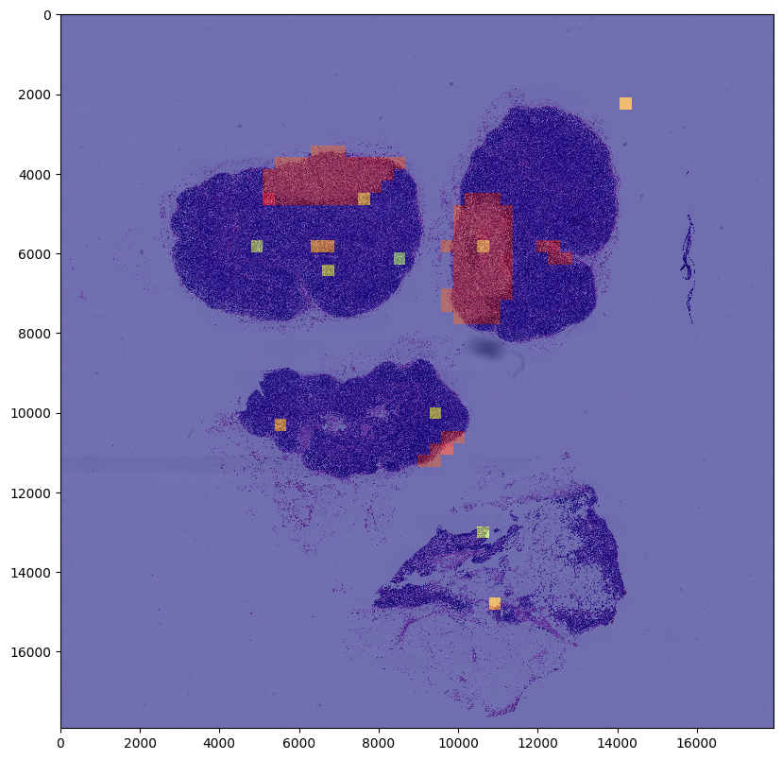
Model 2 Prediction B
Model 2 Prediction – Image 101
Ground Truth – Image 101
f1: 0.9432263633681215
recall: 0.972972885317758
precision: 0.9152541597242237

Slide 18
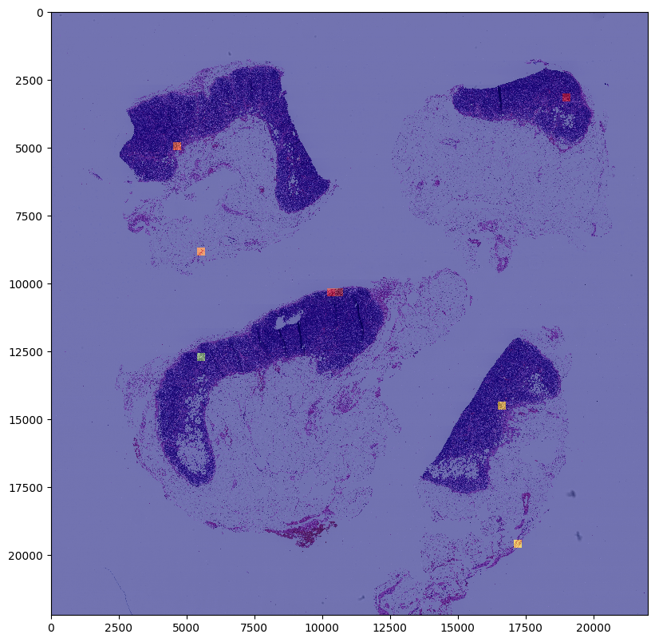
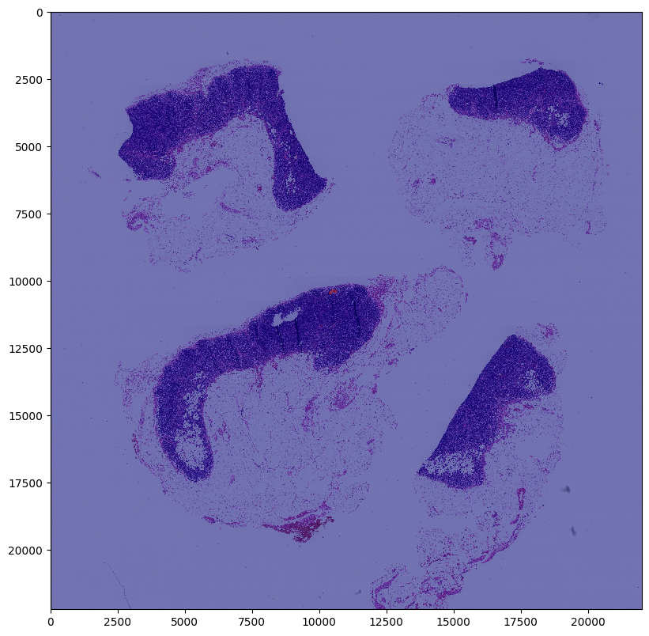
Model 2 Prediction C
Model 2 Prediction – Image 081
Ground Truth – Image 081
f1: 0.3636317355779111
recall: 0.6666644444518518
precision: 0.24999968750039064

Slide 19
Conclusion

Slide 20
Conclusion
The results of both models 1 and 2 stood out as they both managed to achieve over 70% accuracy during training, as measured by the F1 score.
Model 1 achieved over 70% F1 on both training and validation images. On test images, F1 achieved scores of 77%, 88%, and 50% (for the third image precision scored 100%).
Model 2 achieved over 90% on both training and validation images. On test images, F1 achieved scores of 75%, 94%, and 36% (for the third image precision scored 66%).
While both models scored well in terms precision, recall, and F1, Model 2 performed better overall given its degree of accuracy on much larger images. The heatmaps generated by Model 2 provided much finer/ precise areas for inspection, enabling a greater degree of accuracy for potential pathologist.
The principle conclusion I arrived at, with regards to future improvement, is that both models potentially could be further improved by additional training, RAM and GPU capabilities, and ensemble techniques.
From the training history I was able to conclude that additional epochs could be run without the risk of overfitting. In addition, a dropout layer could be added to the output architecture in order to offset overfitting resulting from additional training.
While I was able to develop the project in Google’s Colab, the platform provides only a single GPU and 25GB of RAM. These resources were exhausted throughout the project, limiting some of the potential experiments that could be performed. Future improvements should be completed in GCP, where GPU and RAM capacity can be increased.
Finally, the original paper suggested improved performance is possible through building an ensemble model, wherein models at trained at different resolutions can be aggregated. I can see from the two models I built that there is significant potential for ensemble model to improve accuracy, given that they each achieved unique results on several experiments.

